Slide 1
Health, Education, Public and Professional Services (HEPPS)
May 31,2023

Slide 2
WELCOME TO THE GPTC
MLT PROGRAM INFORMATIONAL MEETING

Slide 3
Georgia Piedmont Medical Laboratory Technician Program
DeKalb Technical College was established in 1961
Clinical Laboratory Assistant program started in 1973
Received initial accreditation in 1976
Medical Laboratory Technology Programs are accredited through the National Accrediting Agency for Clinical Laboratory Sciences (NAACLS).

Slide 4
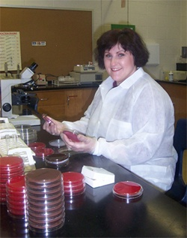
MLT Program
What is Medical Laboratory Technology?
It is a specialized field of study in the analysis of blood and body fluids that aides in the detection, diagnosis and treatment of disease.
What education is required for this field?
2 year Associates degree = MLT
4 year Bachelors degree = MLS/MT/CLS

Slide 5
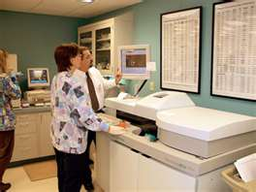
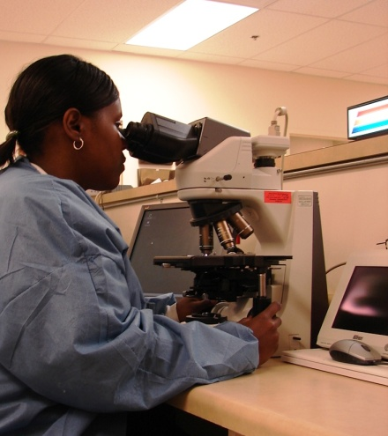
MLT Program
Where do MLT’s and MLS’s work?
Hospital laboratories
Reference laboratories
Public health laboratories
Blood banks
Physician offices
Research centers
Technical Reps for instrumentation companies
Medical Instrumentation Salespersons
Pharmaceutical Salespersons
Quality Control specialists in industry

Slide 6
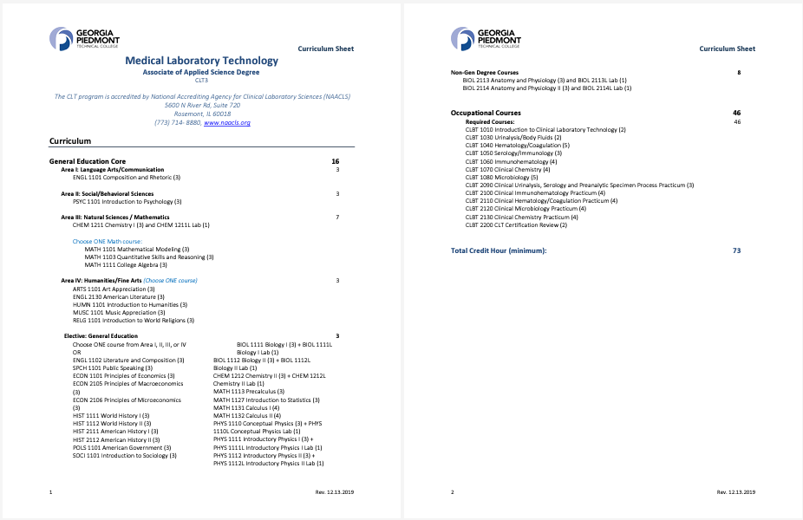
Course Requirements

Slide 7
Competitive Admission Process
Completion of all pre-requisites courses with a grade of C or better
GPA minimum is 2.0 of all required prerequisites
Program admission will be based on GPA of the below course:
BIOL 2113 and BIOL 2113L
BIOL 2113 and BIOL 2113L
CHEM 1211 and CHEM 1211L
The 14 top scoring students will be admitted into the fall program/cohort.
All students must have the Heart Saver BLS Card with expiration date two years after beginning the MLT courses.
Clinical Sites require: Clear background, Urine Drug Screen, and Immunizations

Slide 8
Competitive Admission Process
Next Steps:
Complete the Admission Form
Attach a copy of your GPTC Banner Web Transcript showing all letter grades
All documents must be upload to the MLT drop box by 6/16/23 by 4:30 pm. No other documents will be accepted after this time.
Acceptance emails/letter will be sent out by 7/10/23.
Emails of non-acceptance will be sent out thereafter.
If not accepted, students may apply for other Allied Health Programs (e.g. Phlebotomy, MA, CNA, LPN, HIMT, OPHD, etc.)

Slide 9
Dr. Mayambala
404-297-9522 (ext. 1164) Office: DeKalb A260B mayambalac@gptc.edu

Slide 10
QUESTIONS?

